Slide 1
USMLE Step 2: Clinical skills resources
Compiled by: Calvin Davis, Danielle Scheepers & Patrick McFadden

Slide 2
What is the USMLE STEP 2 CS?
8 hours
12 patient encounters
Assessed on ability to take a medical history, perform a physical exam and communicate both effectively in both written and verbal English
Many test-takers assume the exam will be easy as it is similar to the role medical students have already undertaken during clinical rotations. DO NOT assume so and prepare appropriately!
Plan your test day
Get a good night sleep the 2 nights before the test
Dress professionally and comfortably
Before you enter the room, look at the chief complaint on the door and write down three potential differentials
During the encounter, these will help you ask about important topics
Notes:
Many test takers assume the exam will be easy as it is similar to the role medical students have already undertaken during clinical rotations. DO NOT assume so and prepare appropriately!

Slide 3
The scoring system used
Spoken English Proficiency (SEP)
Clarity:
Pronunciation
Word choice
Does the patient have to ask you to repeat questions or statements
Integrated Clinical Encounter (ICE)
Standardized Patients use a checklist to grade your skills in gathering and interpreting data during the physical exam.
Physician-evaluators rate the content on your note that you enter into the computer following the exam
Communication and Interpersonal Skills (CIS)
Measures skills of patient care
Patient-centered communication
Putting the patient at ease
Gathering and providing information in an understandable manner
Notes:
SEP - This section is graded by the standardized patients by assessing how much effort they need to expend to understand what you are asking or explaining.

Slide 4
TIPS ON HOW TO PREPARE
Time yourself – 15 minutes with the patient and 10 minutes to type the note
Practice on a peer wearing a gown (you will need to remember to ask them to untie or remove part of the gown for the exam.)
Asking for permission to remove the gown (if needed) establishes a rapport with your patient
Practicing with peers is a great way to prepare
Usually quite easy to find willing participants as a lot of students will be doing the same thing
Practice typing as you will be analyzed for spelling errors and there will be no spell-check
A week before the exam, simulate a full exam with 12 cases and allotted breaks

Slide 5
REMEMBER
Each patient requires a focused approach – you do no need to perform a complete history and physical on each patient.
Practice using official USMLE note templates as these may be different from what you are accustomed to on the wards.
Even though the situation is contrived, you must get into character and make your patients feel that you are a physician who cares about them and so some acting on your part may be required to keep composure

Slide 6
REMEMBER
Use correct terminology (avoid slang)
Give a detailed documentation of patient history and physical exam such as “regular rate and rhythm with no murmurs, rubs, or gallops” rather than “heart rate normal”
Diagnosis supported with findings obtained from history and physical exam - do not assume a diagnosis due to the history given, make an evidence based diagnosis.
Give your diagnosis listed in correct order of likelihood
If you are left with extra time from the patient encounter, use it for drafting a patient note.

Slide 7
Types of resource materials:
Websites – USMLE website, Lecturio, UWorld, Pathoma, Sketchy Medical, Goljan audio lectures
Online videos – YouTube channels, Boards and Beyond
Blog sites
Textbooks & Articles – First aid for USMLE, USMLE Step 2 clinical skills triage, Brochert’s Crush step 2, BRS Pathology, Gross anatomy & Physio
Flash cards – Lange Pharmacology
Study plans - Kaplan Qbank
Schedule planner – Cram Fighter
Class notes
Medicine faculty review lectures
Mobile apps – MEDizzy, UWorld USMLE app, Anki notes app

Slide 8
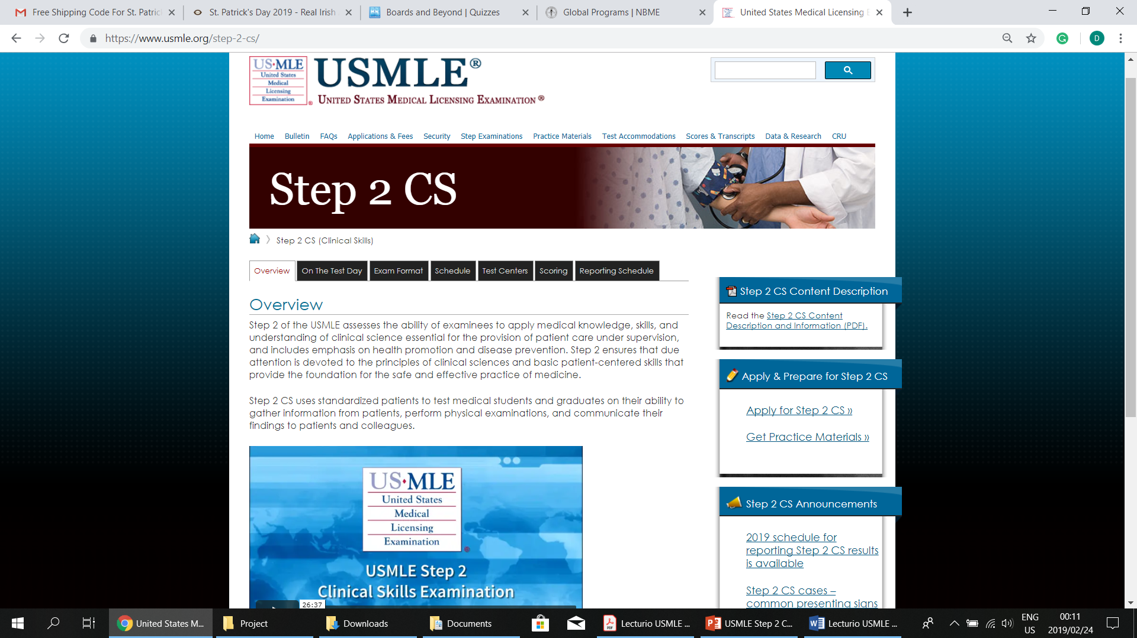
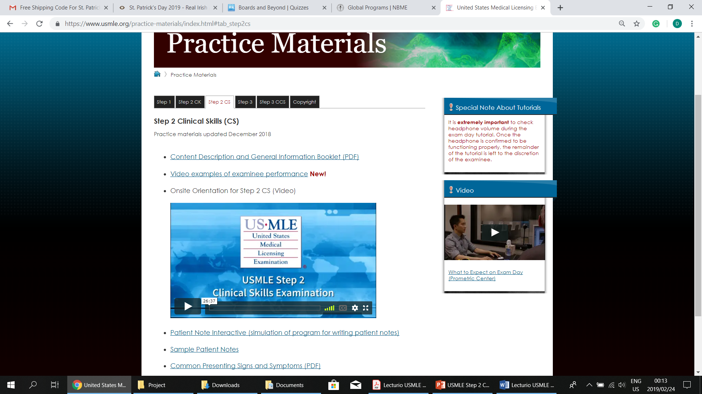
Usmle website resources & tips:
Image 1
Image 2

Slide 9
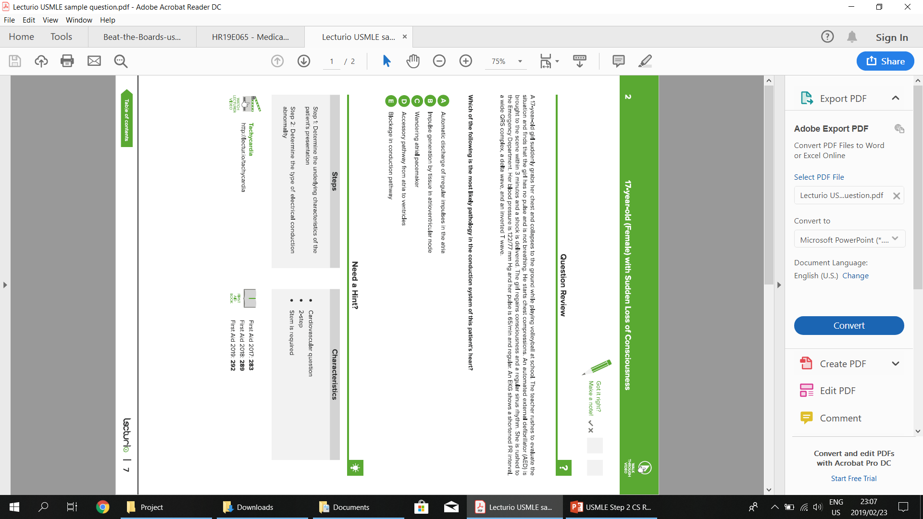
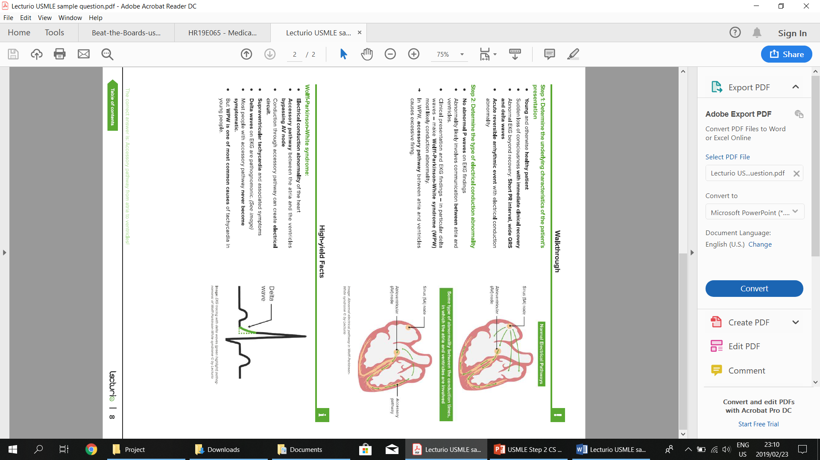
Sample of LECTURIO USMLE NOTES:
Image 3
Image 4

Slide 10
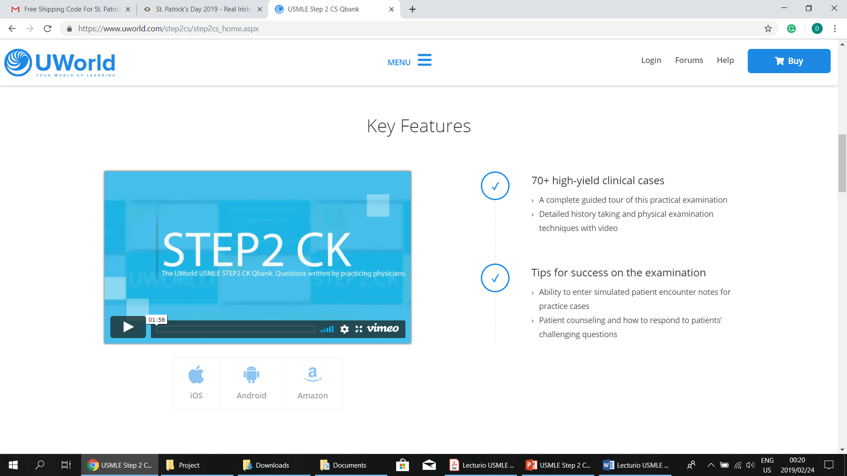
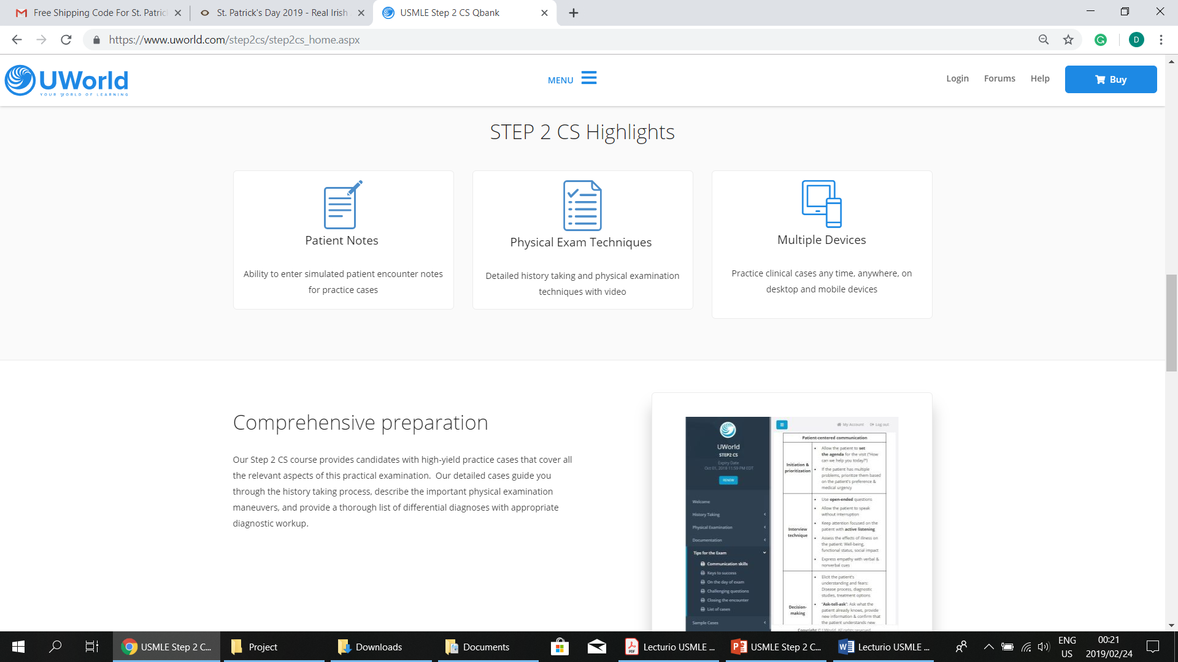
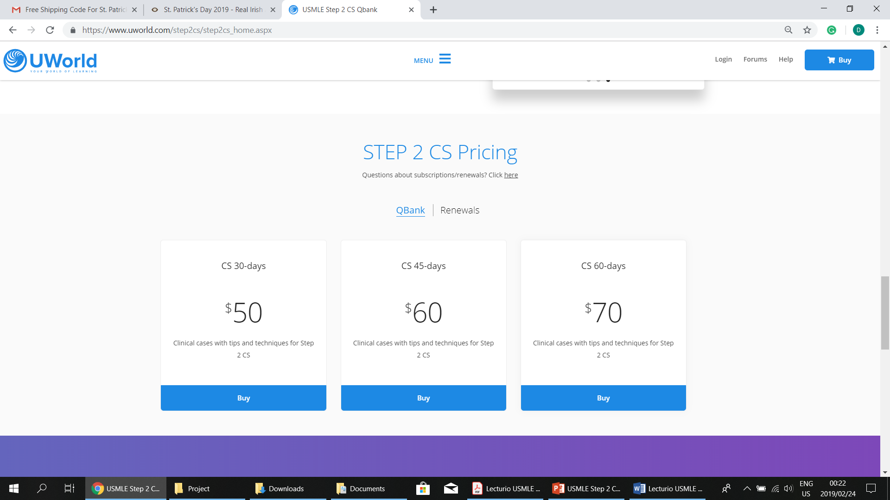
UWORLD STUDY PACKAGE:
Image 5
Image 6
Image 7

Slide 11
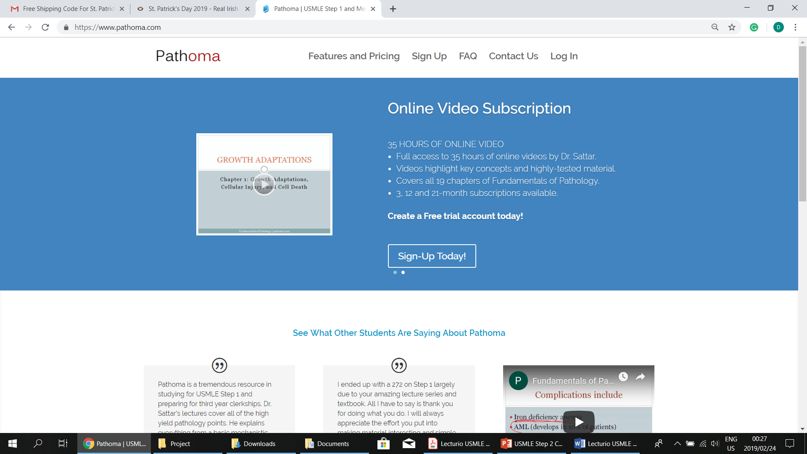
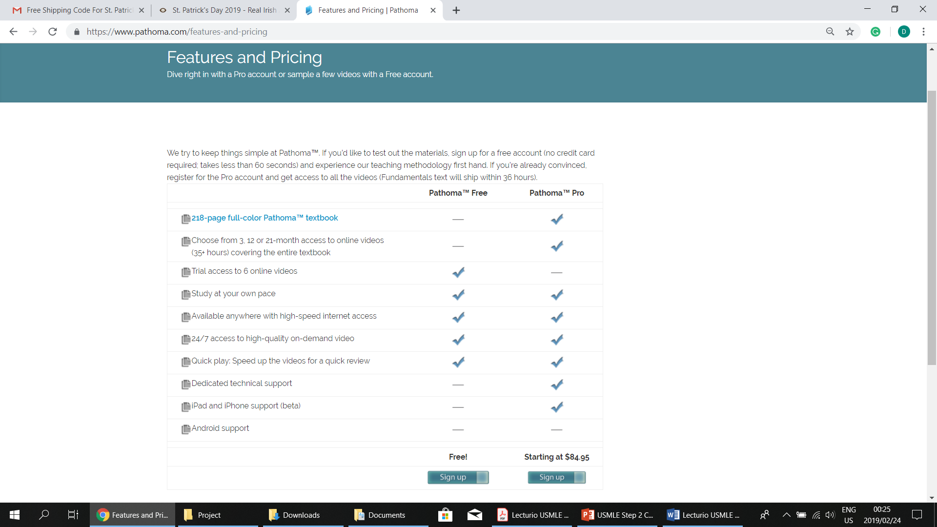
PATHOMA STUDY SUBSCRIPTION
Image 8
Image 9

Slide 12
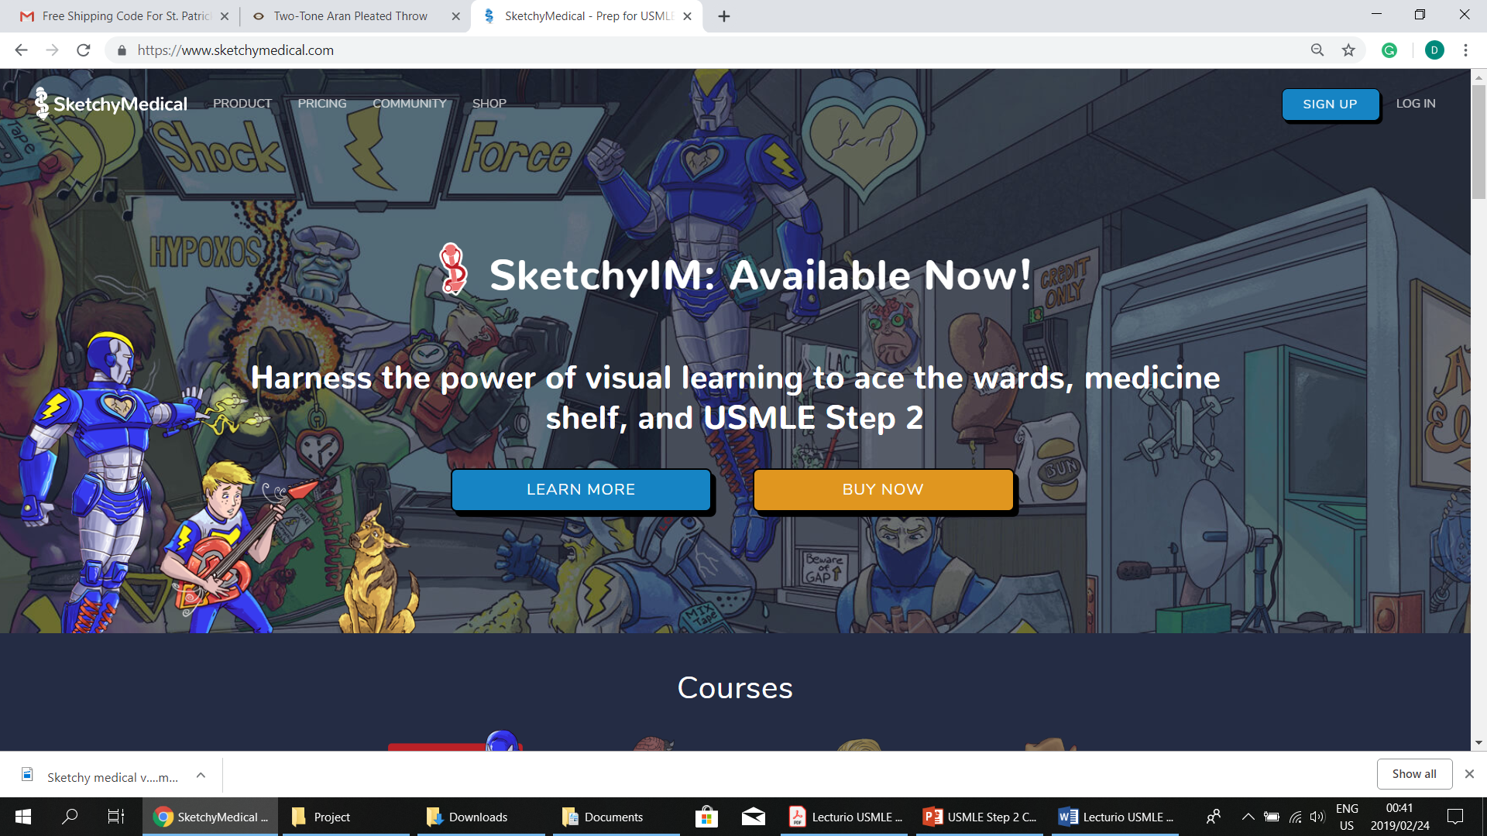
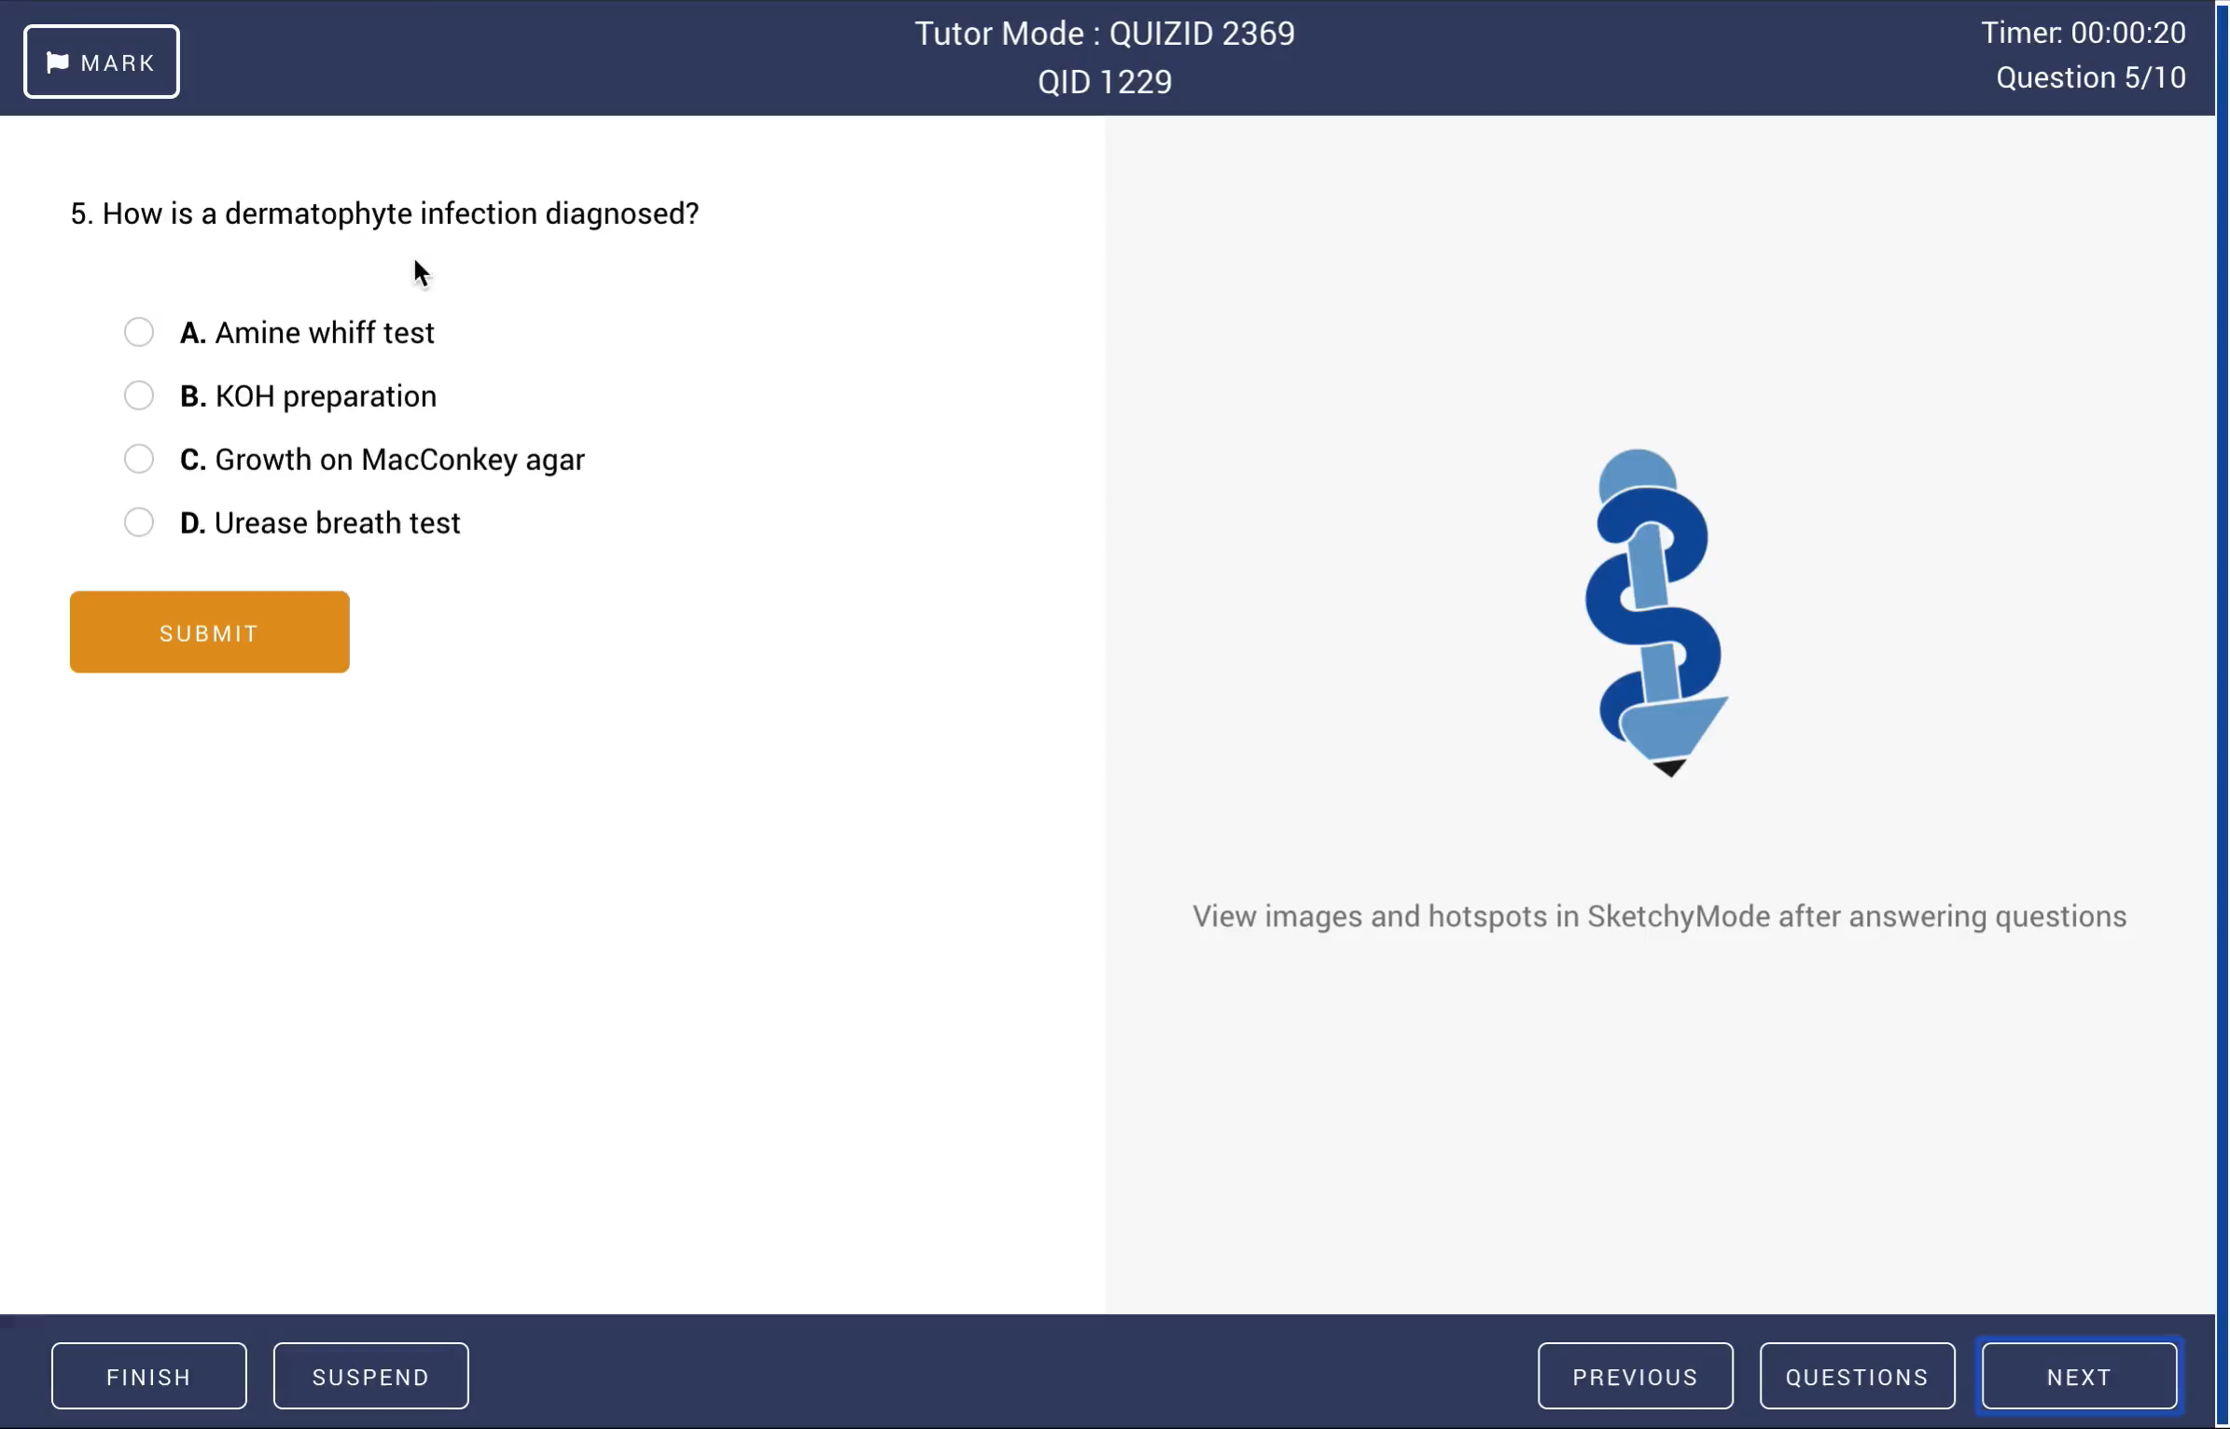
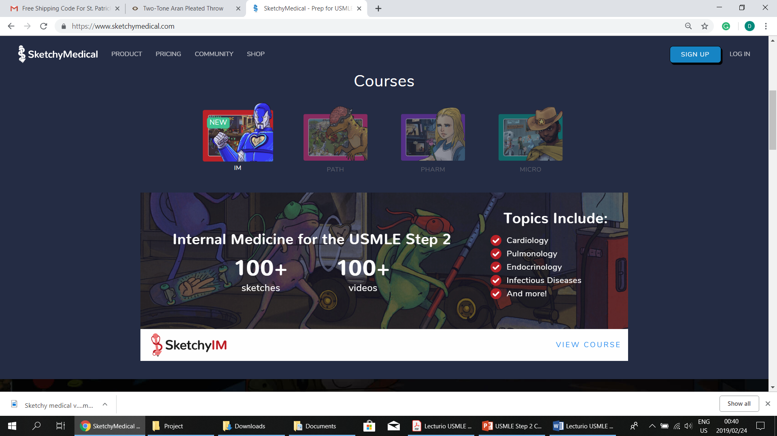
SKETCHY MEDICAL STUDY METHOD
Image 10 & 11, Video 1

Slide 13
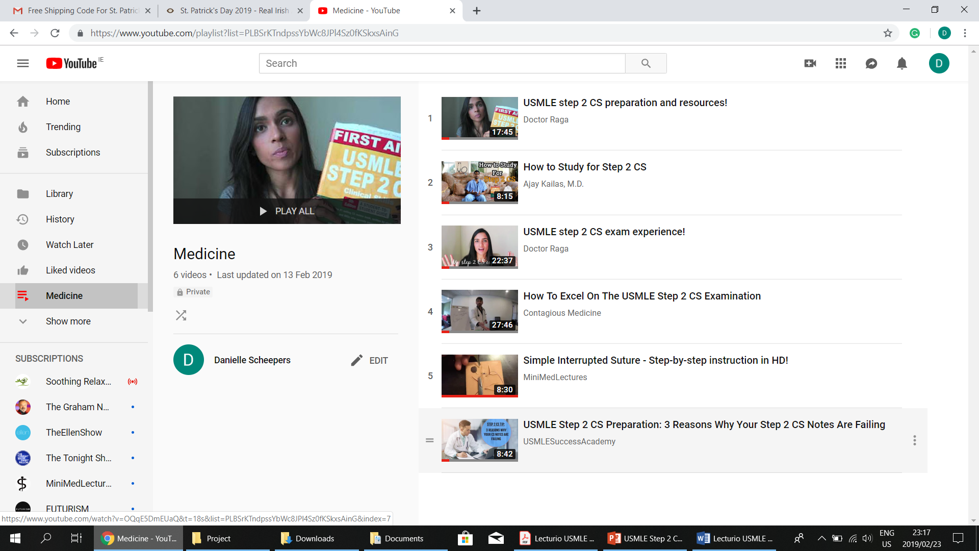

YouTube video resources
Image 12, Video 2

Slide 14
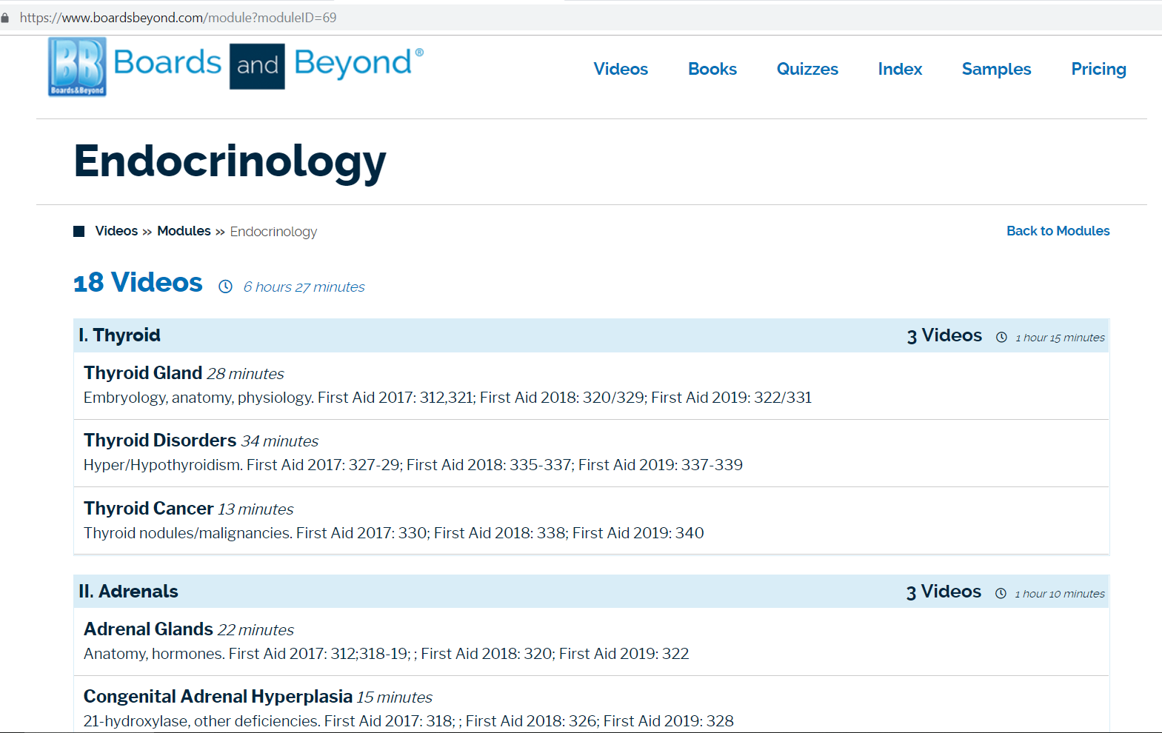
Boards & beyond videos on selected topics:
Image 13

Slide 15
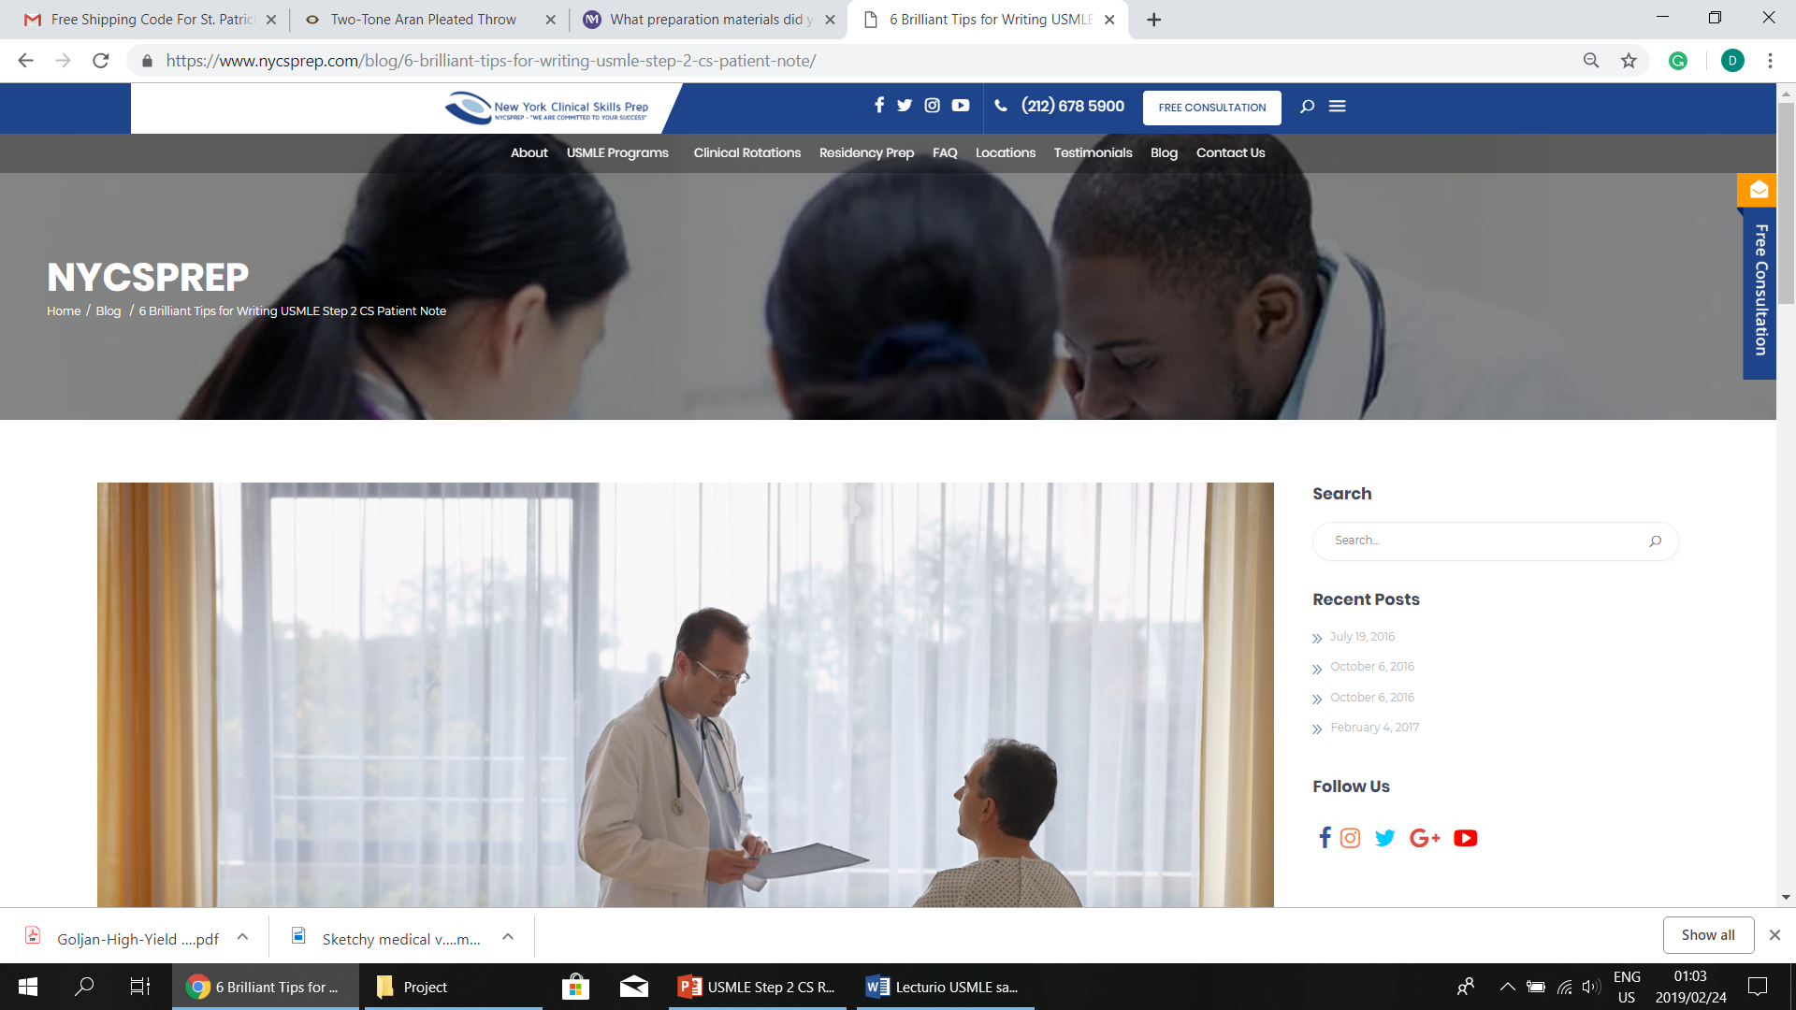
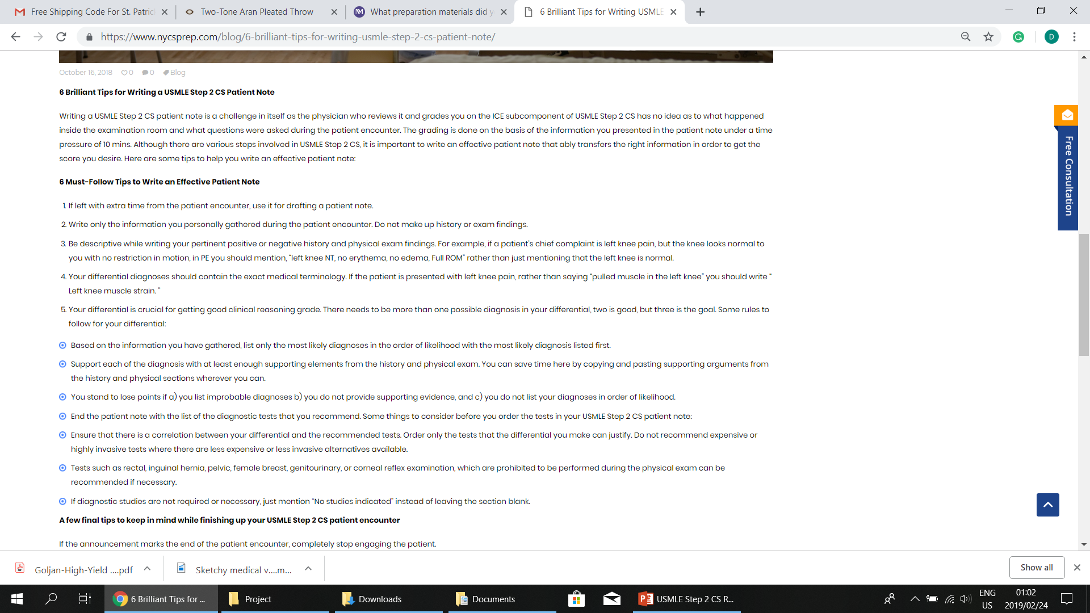
BLOGS
Image 14

Slide 16
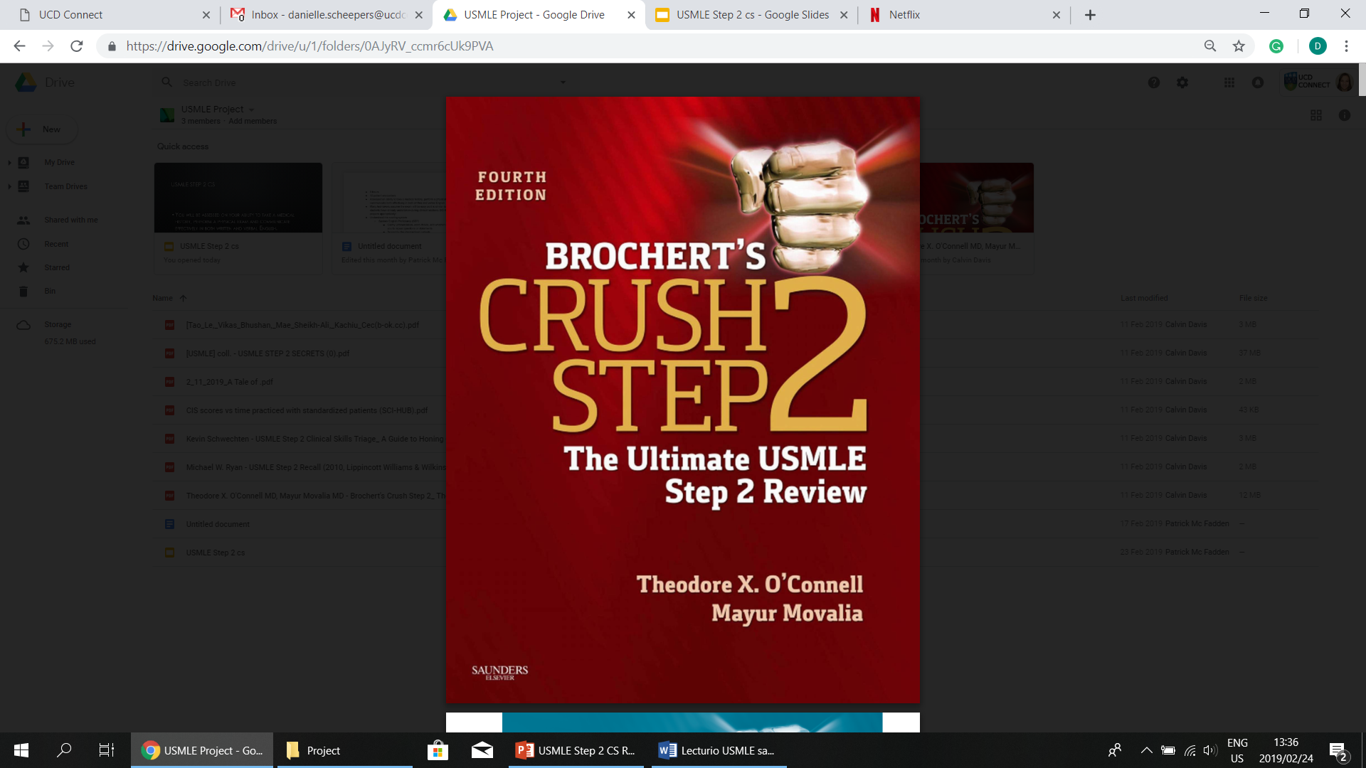
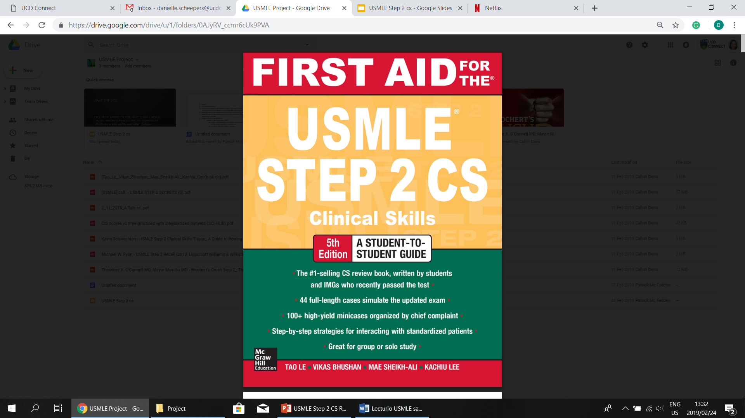
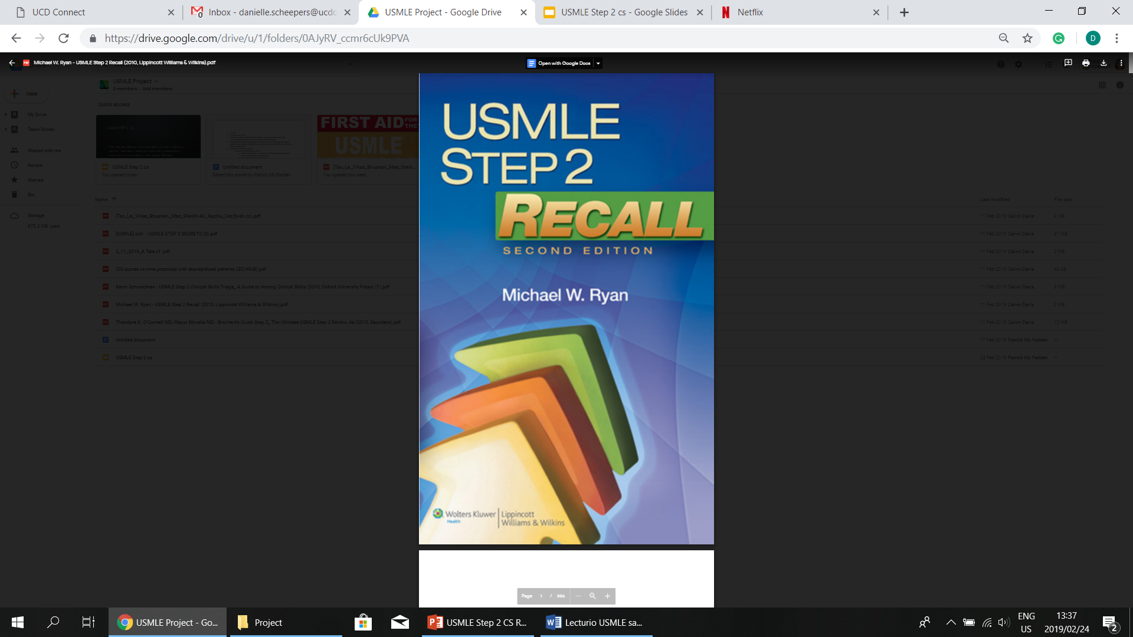
Books
The wide array of review books on the USMLE Step 2 CS are great resources for improving the Integrated Clinical Encounter (ICE) and Communication and Interpersonal Skills (CIS) components of the exam.
Focus on books that contain high-yield patient-doctor case studies on a variety of different types of patients.
Image 16
Image 15
Image 17

Slide 17
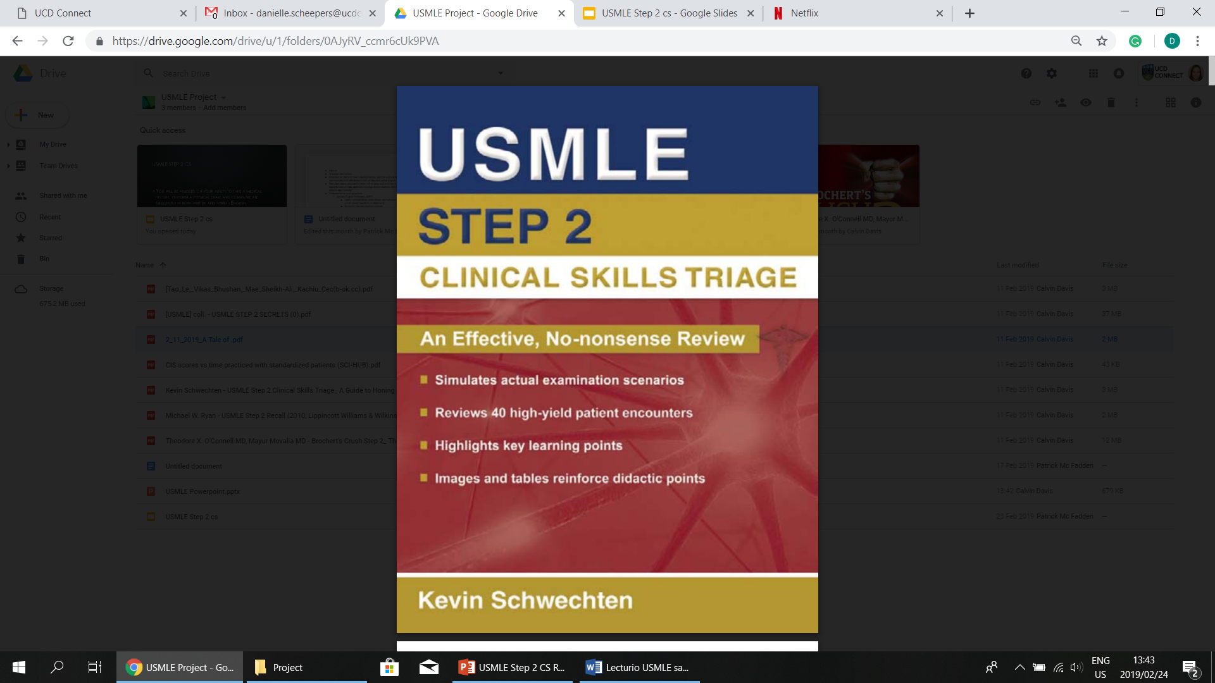
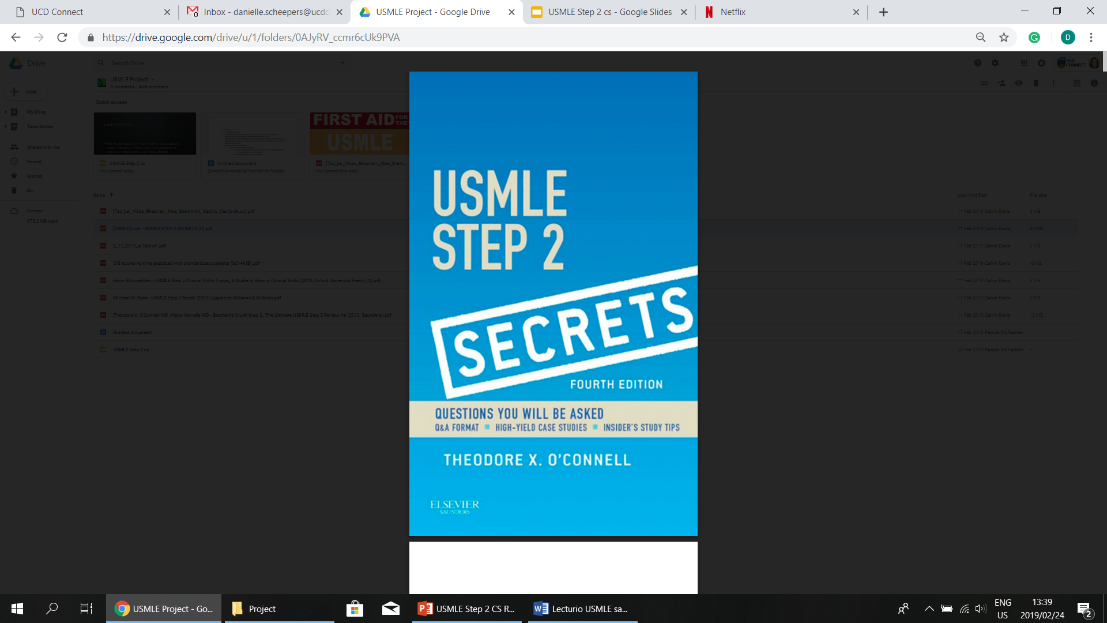
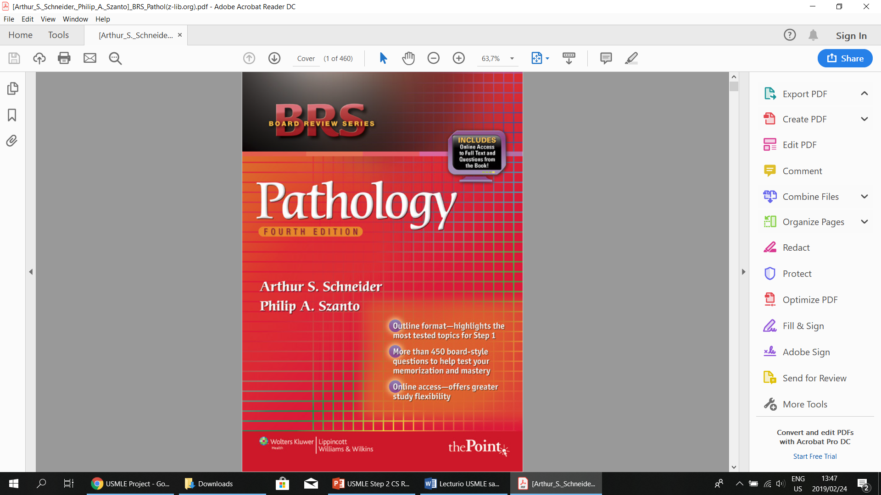
BOOKS
Image 18
Image 20
Image 19

Slide 18
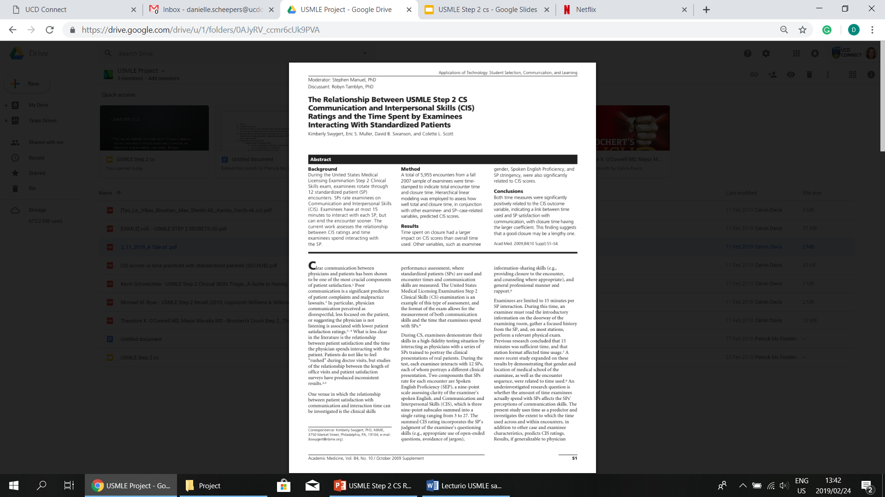
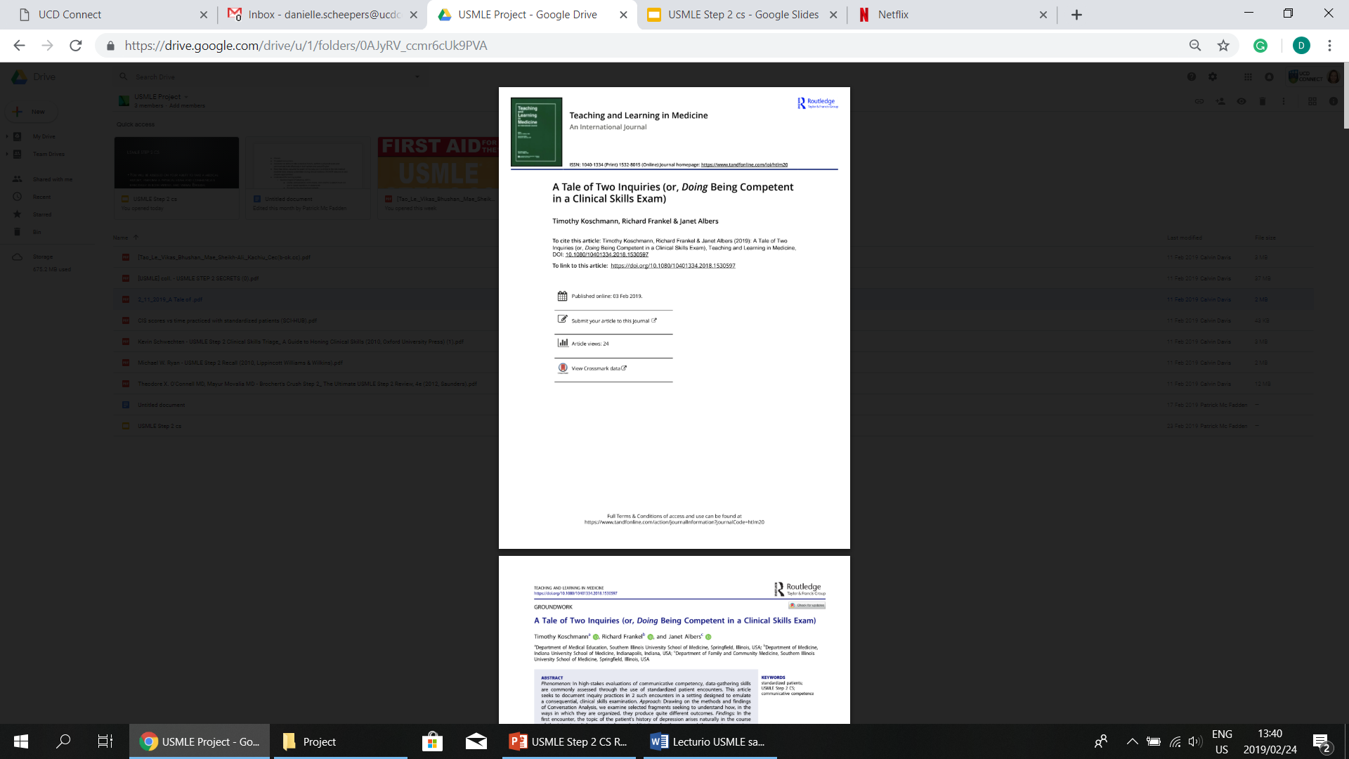
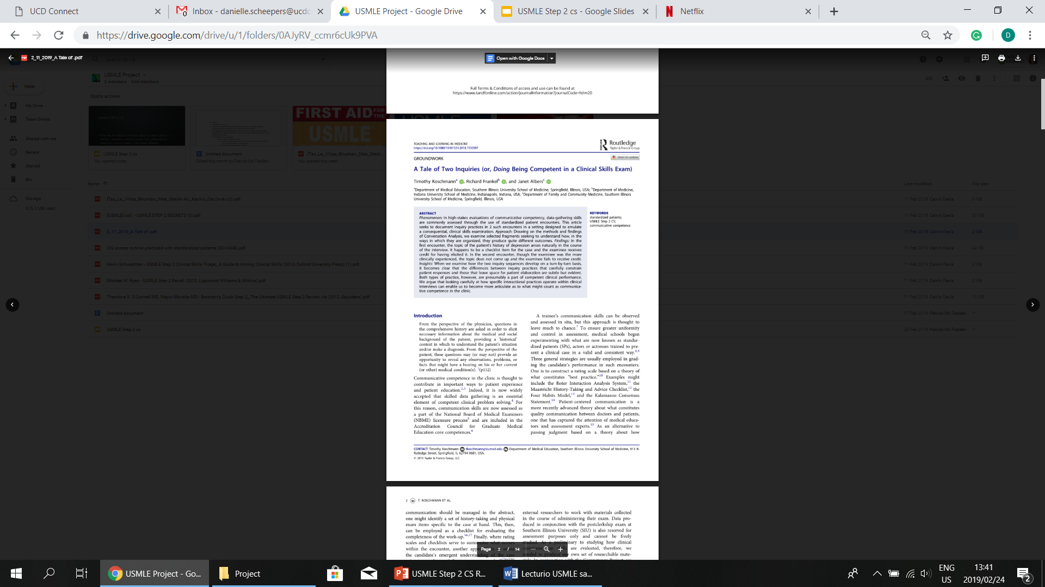
Articles:
Image 21
Image 22
Image 23

Slide 19
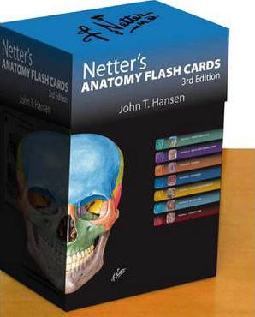
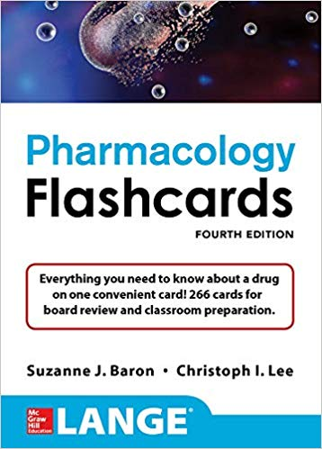
FLASH CARDS
Image 24
Image 25

Slide 20
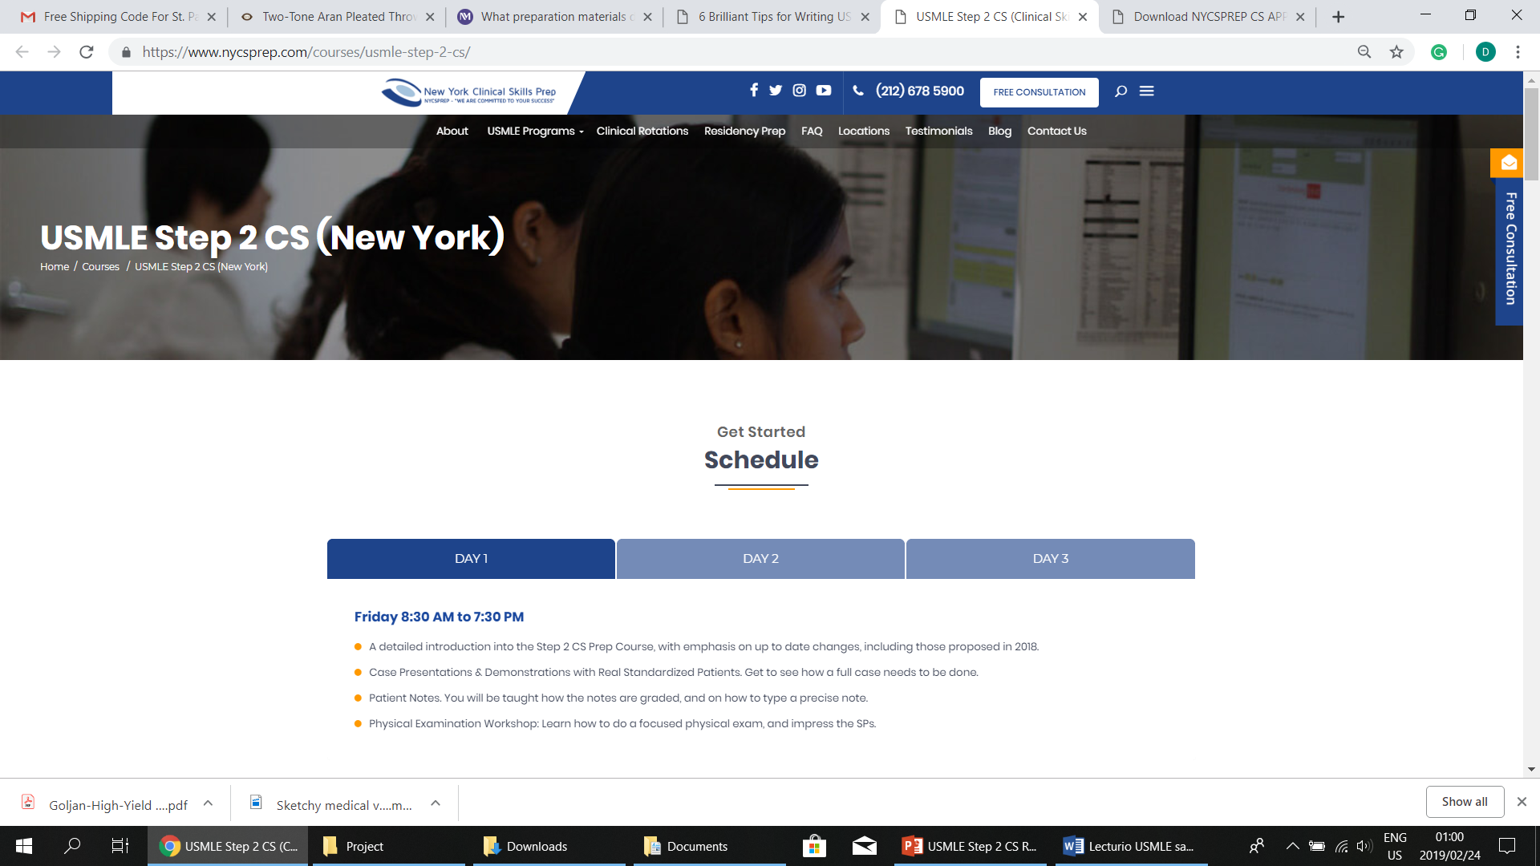
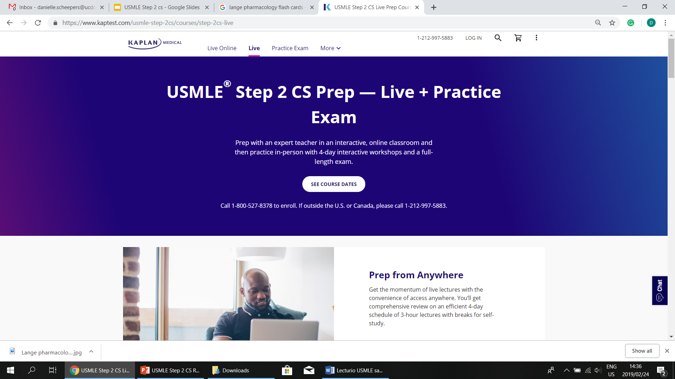
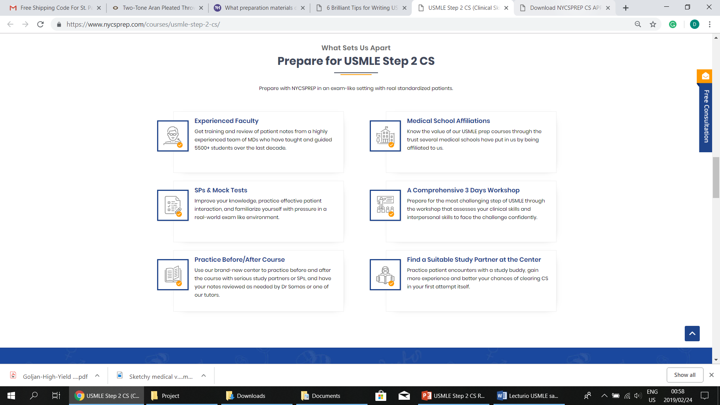
STUDY PLANS
Image 28
Image 26 & 27

Slide 21
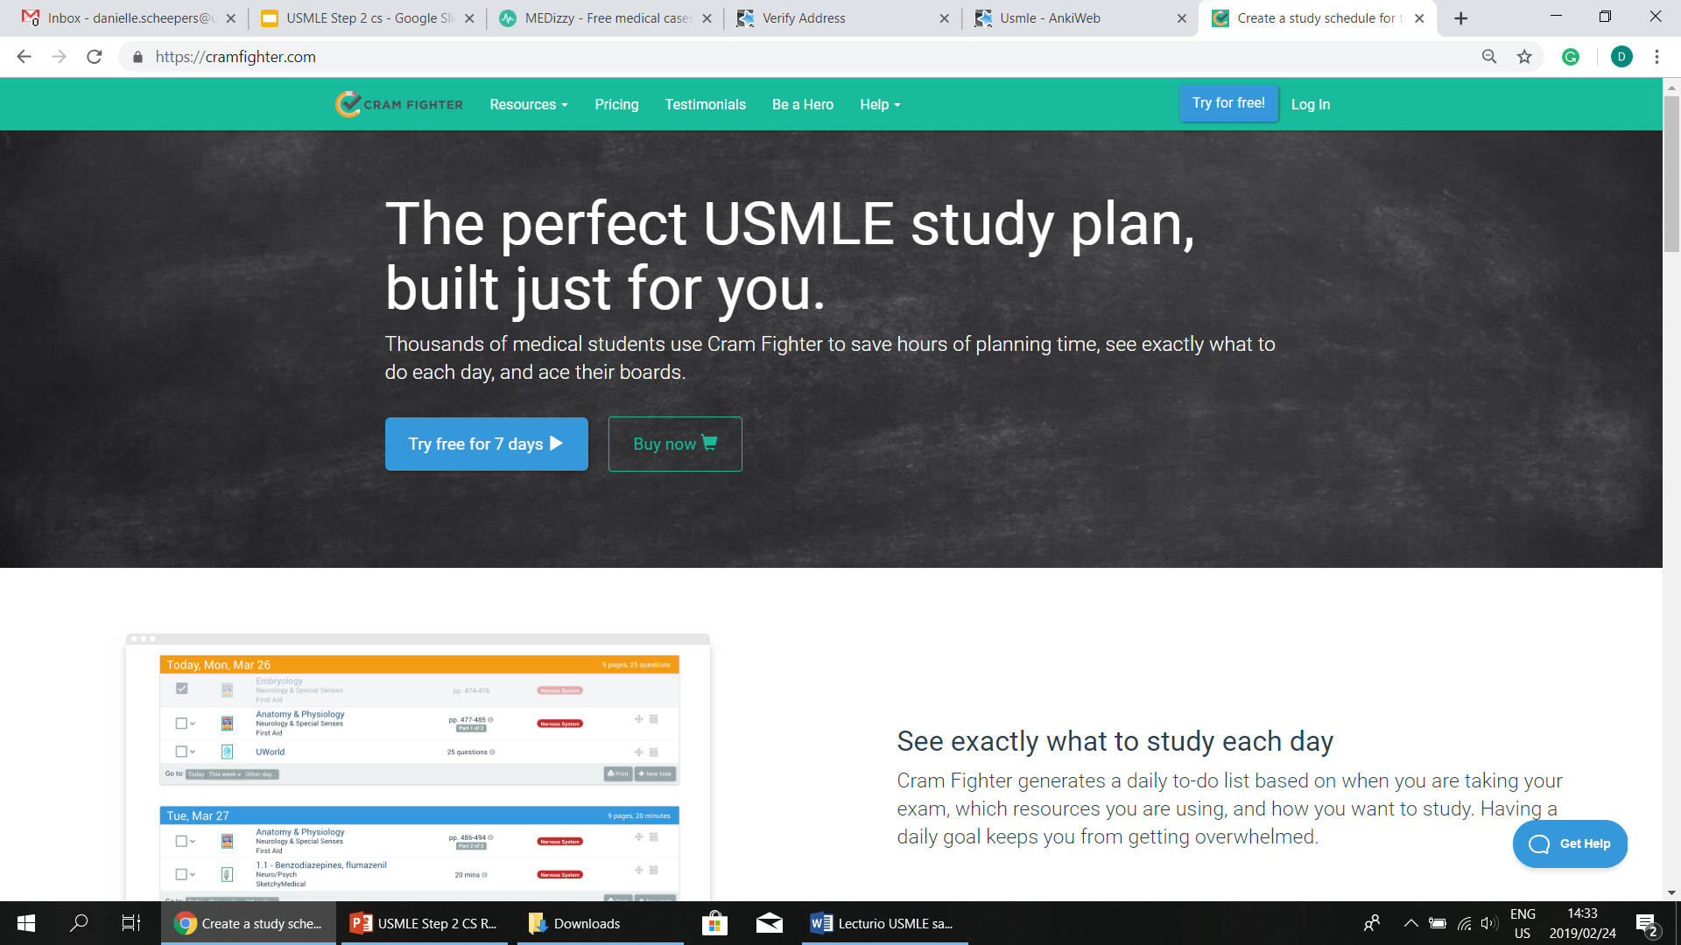
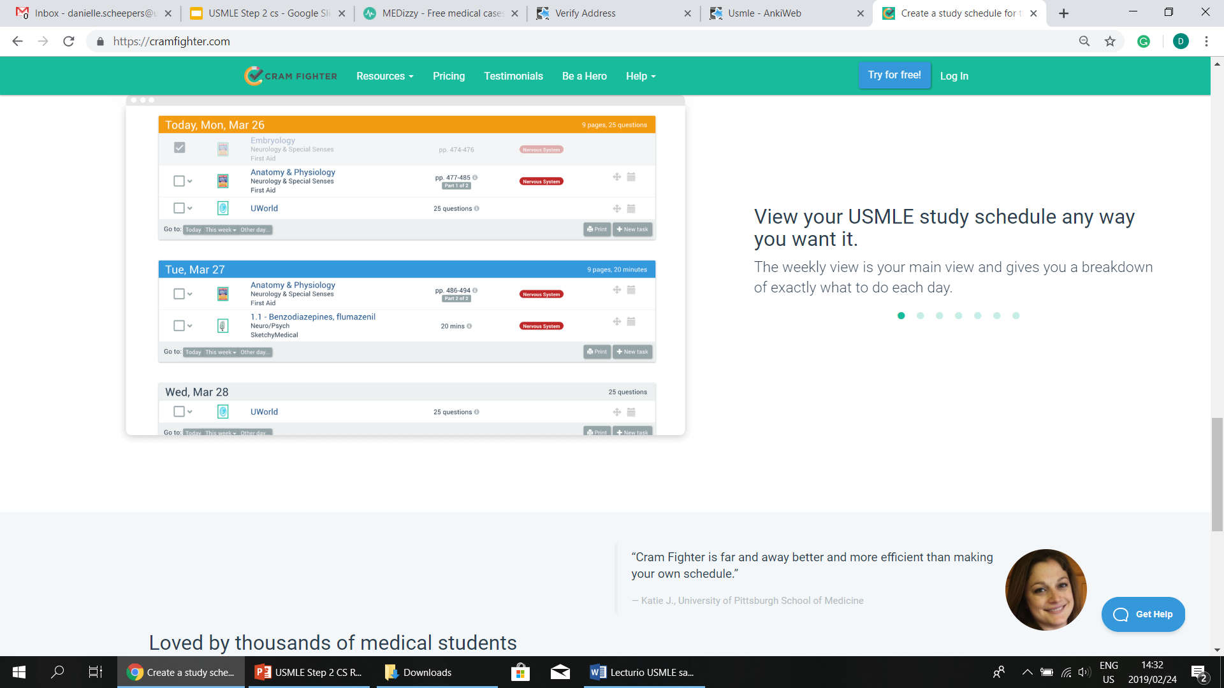
SCHEDULE PLANNER
Image 29
Image 30

Slide 22
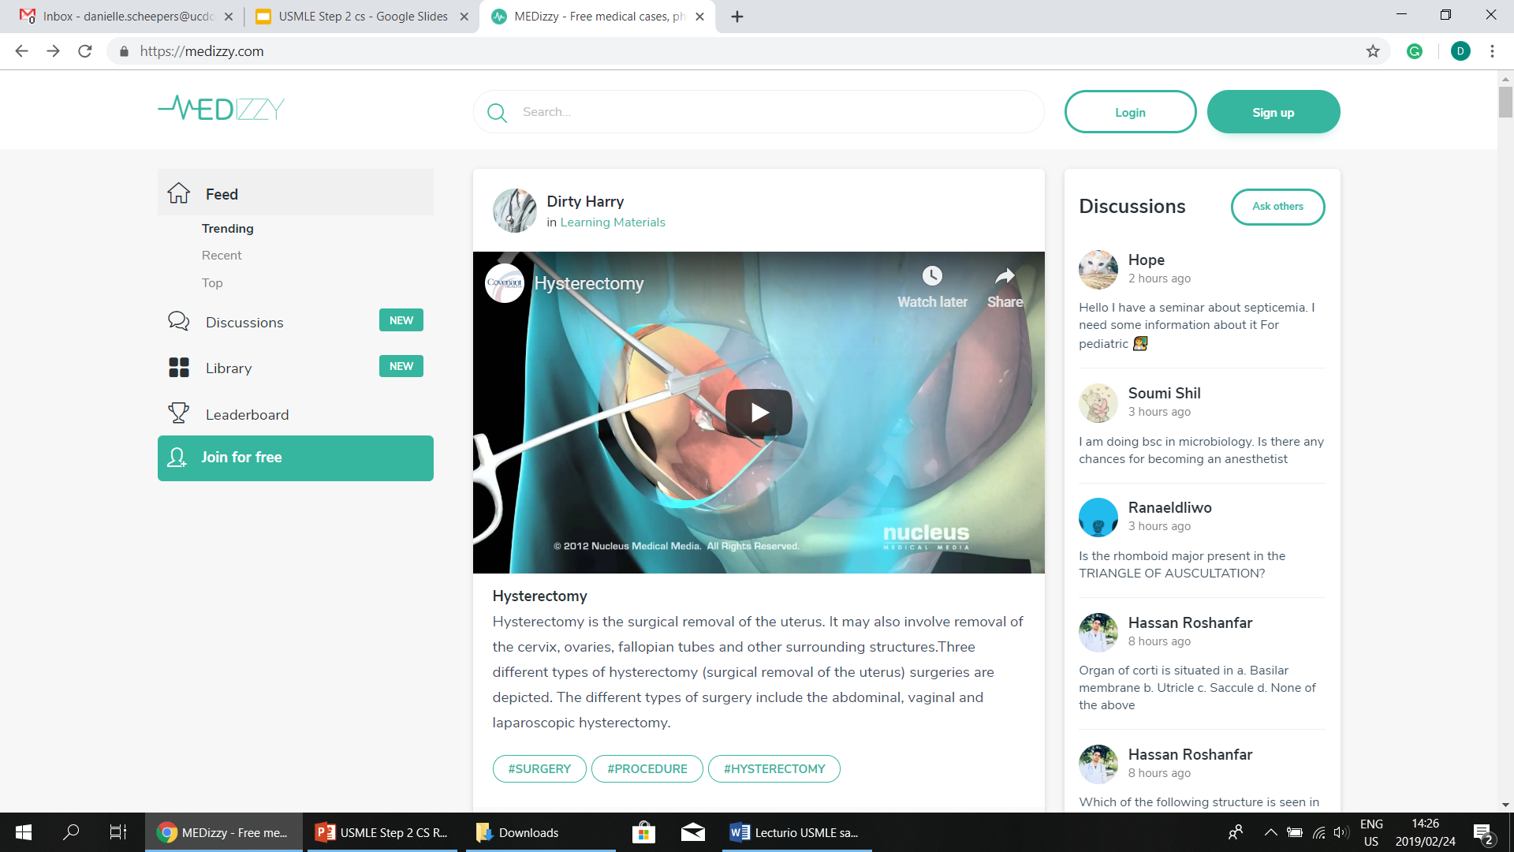
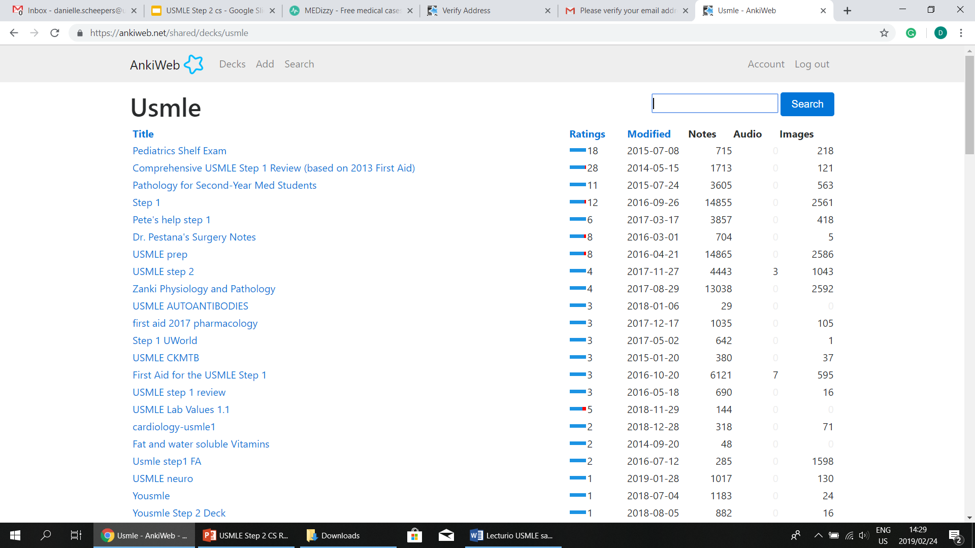
Mobile apps
Image 31
Image 32

Slide 23
FURTHER NOTES ON THE CIS COMPONENT
Your primary focus for preparing for this aspect of the exam should be on developing and honing the following skills:
Your ability to question the patient.
Acting professional throughout the encounter and building a rapport with the patient.
Sharing your findings with the patient.
This can be done by looking over transcripts of practice cases.

Slide 24
TAKE CARE WHEN QUESTIONING YOUR PATIENT
Questions should leave room for the patient to elaborate and questions with one word answers should be avoided wherever possible.
Leading questions should be avoided.
Try not to repeat questions.
Do not interrupt the patient while they are talking.

Slide 25
BUILDING A RELATIONSHIP WITH YOUR PATIENT WHILE MAINTAINING PROFESSIONALITY
Introduce yourself to the patient. First impressions count!
Washing your hands before carrying out a physical examination demonstrates sanitation!
Show compassion and empathy towards the patient throughout the exam.
Give your patient the opportunity to express their concerns and take these concerns into account.
Do not directly contradict the patient’s beliefs.

Slide 26
BE CONSIDERATE WHEN BREAKING INFORMATION TO THE PATIENT!
Acknowledge and try to alleviate the patient’s concerns.
Explain any medical terms that you use. Remember, to the patient it’s all scientific jargon!
Provide information about the next step(s) in the patient’s diagnosis/intervention.

Slide 27
IMPROVING YOUR ICE SCORES:
As data gathering skills are based on whether or not you asked the questions listed on the SP’s checklist, it would be a good idea to use the patient case studies to note what questions you will be expected to ask.
Use review books to sharpen your interpretation skills by learning the likeliest diagnoses for given signs and symptoms.
Notes:
Integrated Clinical Encounter

Slide 28
SUMMARY
There are multiple resources that one can use
It depends on which study method you use best and how you like to organize yourself

Slide 29

THANK YOU!!

Slide 30
references
https://www.feinberg.northwestern.edu/md-education/current-students/academic-support/preparation-resources/helpful-resources.html
https://www.nycsprep.com/courses/usmle-step-2-cs/
https://www.nycsprep.com/blog/6-brilliant-tips-for-writing-usmle-step-2-cs-patient-note/
Le, T. et al. (2014) First Aid for the USMLE Step 2 CS. 5th ed. New York: McGraw-Hill.
O’Connell, T.X. and Movalia, M.K. (2013) Brochert’s Crush Step 2: The Ultimate USMLE Step 2 Review. 4th ed. Philadelphia: Saunders.
Ryan, M.W. (2011) USMLE Step 2 Recall. 2nd ed. Philadelphia: Lippincott Williams & Wilkins.
Schwechten, K. (2010) USMLE Step 2 Clinical Skills Triage. New York: Oxford University Press.
https://www.noodle.com/articles/5-practical-tips-to-prepare-for-the-usmle-step-2-cs

Slide 31
References for images:
Image 1 & 2: USMLE Website: https://www.usmle.org/practice-materials/index.html#tab_step2cs
Image 3 & 4: Lecturio: https://www.lecturio.com/
Image 5, 6 & 7: UWorld: https://www.uworld.com/step2cs/step2cs_home.aspx
Image 8 & 9: Pathoma: https://www.pathoma.com/
Image 10 & 11: Sketchy Medical: https://www.sketchymedical.com/
Image 12: YouTube: https://www.youtube.com/watch?v=R25mwA6coXg&list=PLBSrKTndpssYbWc8JPl4Sz0fKSkxsAinG&index=1
Image 13: Boards and Beyond: https://www.boardsbeyond.com/module?moduleID=69
Image 14: NYCS Prep Blog: https://www.nycsprep.com/blog/6-brilliant-tips-for-writing-usmle-step-2-cs-patient-note/
Image 15: First Aid for USMLE Step 2 CS: Le, T. et al. (2014) First Aid for the USMLE Step 2 CS. 5th ed. New York: McGraw-Hill.
Image 16: Brochert’s Crush Step 2: The ultimate USMLE Step 2 Review: O’Connell, T.X. and Movalia, M.K. (2013) Brochert’s Crush Step 2: The Ultimate USMLE Step 2 Review. 4th ed. Philadelphia: Saunders.
Image 17: USMLE Step 2 Recall: Ryan, M.W. (2011) USMLE Step 2 Recall. 2nd ed. Philadelphia: Lippincott Williams & Wilkins.

Slide 32
REFERENCES FOR IMAGES:
Image 18: USMLE Step 2 Clinical skills Triage: Schwechten, K. (2010) USMLE Step 2 Clinical Skills Triage. New York: Oxford University Press.
Image 19: BRS Pathology: Schneider, A. S. & Szanto, P. A., 2009. Board Series Review Pathology. 4th ed. China: Lippincott Williams & Wilkins, a Wolters Kluwer business.
Image 20: USMLE Step 2 Secrets: O'Connell, T. X., 2014. USMLE Step 2 Secrets: Questions you will be asked. 4th ed. Chicago: Elsevier Saunders.
Image 21: The Relationship Between USMLE Step 2 CS Communication and Interpersonal Skills (CIS) Ratings and the time spent by Examinees interacting with standardized patients Article: Swygert, K., Muller, E. S., Swanson, D. B. & Scott, C. L., 2009. The Relationship Between USMLE Step 2 CS Communication and Interpersonal Skills (CIS) Ratings and the time spent by Examinees interacting with standardized patients. Academic Medicine, October.83(10).
Image 22 & 23: A Tale of Two Inquiries (or, Doing Being Competent in a Clinical Skills Exam) Article: Koschmann, T., Frankel, R. & Albers, J., 2019. Teaching and learning in Medicine: An International journal. A Tale of Two Inquiries (or, Doing Being Competent in a Clinical Skills Exam).
Image 24: Netter’s Anatomy Flash cards: https://d1w7fb2mkkr3kw.cloudfront.net/assets/images/book/lrg/9781/4377/9781437716757.jpg
Image 25: Lange Pharmacology Flash cards: https://images-na.ssl-images-amazon.com/images/I/51MHSl2SrRL._SX356_BO1,204,203,200_.jpg
Image 26 & 27: NYCS Prep Study plan: https://www.nycsprep.com/courses/usmle-step-2-cs/
Image 28: Kaplan Medical: https://www.kaptest.com/usmle-step-2cs/courses/step-2cs-live
Image 29 & 30: Cram Fighter: https://cramfighter.com/
Image 31: MEDizzy app: https://medizzy.com/
Image 32: Anki Web: https://ankiweb.net/shared/decks/USMLE

Slide 33
REFERENCE FOR VIDEOS:
Sketchy Medical: https://www.sketchymedical.com/assets/images/home/recall/MP4/micro@1200.mp4
USMLE Step 2 CS Prep: 3 Reasons Why your step 2 CS notes are failing: https://youtu.be/OQqE5DmEUaQ?list=PLBSrKTndpssYbWc8JPl4Sz0fKSkxsAinG
Thank you, next video: https://www.youtube.com/watch?v=rHGcCNNdAX0

